Slide 1


Department of Information Science and Engineering
Department of Information Science and Engineering
Project Phase - Final
MINIMISING GAUSSIAN NOISE FROM REAL TIME CCTV IMAGES USING GAN
Project Batch and USN
BATCH B34
Guide Name, and Designation
Dr. MANOJ KUMAR Mr. PRASHANT B S
Associate Professor Assistant Professor
ADYAPADI SURAJ 1NT20IS012
AKSHAY PRASHANT HEGDE 1NT20IS015
PRANAVA AITHAL 1NT20IS112
Date:-05/05/2024

Slide 2
Contents
Motivation 8. Objectives
Abstract 9. Methodology
Introduction 10. Architecture diagram
Literature Review 11. Important code snippets
Research/ Project Issues 12. Result and discussion
Problem statement 13. Future scope
Software Requirement Specification 14. References

Slide 3
Motivation
The appearance of undesired noises in images of genuine scenes has become a regular challenge in today's digital age. Conventional denoising techniques frequently fail to distinguish between noise and crucial image characteristics, resulting in the loss of vital data or the creation of artefacts. Generative Adversarial Networks (GANs) are a promising development that may offer a solution to this problem. The goal of this project is to investigate how GANs can be used to improve the quality of real-world scene images.

Slide 4
Abstract
In our project, we offer a system for removing undesirable noise from real-world scene images using generative adversarial networks (GANs). Images with unwanted noise can have poorer visual quality and be more difficult to interpret. In our method, a discriminator network directs the training of a generator network to generate denoised images from noisy inputs. The framework consists of processes like noise reduction, picture enhancement, and evaluation with PSNR and SSIM metrics. The resulting denoised images show better visual quality and have potential for use in computer vision and image analysis.

Slide 5
Introduction
Images of genuine scenes often have unwanted noise that drastically reduces the visual quality and makes them more difficult to interpret. We offer a framework that uses Generative Adversarial Networks (GANs) to reduce undesired noise and improve the visual quality of real scene images in order to address this problem.
The two main components of our framework are noise removal and image enhancement. A discriminator network distinguishes between clean and produced images, whereas a generator network learns to convert noisy images into clean versions through adversarial training.

Slide 6
Literature Review
SL NO | PAPER TITLE | AUTHOR | OBSERVATION | OUTCOMES / LIMITATIONS
1. | An Unbiased Risk Estimator for Image Denoising in the Presence of Mixed Poisson–Gaussian Noise, Gaussian noise estimation with superpixel classification in digital images, Undecimated wavelet-based Bayesian denoising in mixed Poisson-Gaussian noise with application on medical and biological images | Y. Le Montagner, E. D. Angelini and J. -C. Olivo-Marin, C. -H. Wu and H. -H. Chang L. Boubchir, S. Al-Maadeed and A. Bouridane | All three papers propose novel methods for denoising images affected by mixed Poisson-Gaussian noise, common in biomedical and digital image processing. The first introduces a Poisson–Gaussian unbiased risk estimator (PG-URE) to optimize denoising algorithms, focusing on fluorescence bioimaging. The second suggests a statistical approach based on superpixel maps for noise variance estimation, promising automation for restoration tasks. Lastly, the third presents a Bayesian denoising method with a Generalized Anscombe transform, outperforming existing techniques, especially in high noise scenarios, while preserving fine details. These contributions advance denoising techniques for complex noise types. | The first paper proposes a new PG-URE estimator to optimize denoising algorithms for fluorescence bioimaging. The second paper introduces a superpixel-based method for estimating Gaussian noise variance in images, showing potential for automation in restoration applications. The third paper presents a Bayesian denoising methodology tailored for biomedical images with mixed Poisson-Gaussian noise, outperforming existing methods in high noise scenarios while preserving fine details.

Slide 7
Literature Review
SL NO | PAPER TITLE | AUTHOR | OBSERVATION | OUTCOMES
2. | Multi-Scale Patch-Based Image Restoration EDCNN: A Novel Network for Image Denoising A New Generative Adversarial Network for Texture Preserving Image Denoising | V. Papyan and M. Elad H. Zou, R. Lan, Y. Zhong, Z. Liu and X. Luo Q. ZhiPing, Z. YuanQi, S. Yi and L. XiangBo | These abstracts highlight advancements in image denoising techniques. The first paper enhances the expected patch log likelihood (EPLL) method by integrating a multi-scale prior, improving denoising, deblurring, and super-resolution tasks. The second paper introduces an enhanced deep convolutional neural network (EDCNN) that outperforms existing methods, particularly on images with high-level noise. Lastly, the third paper presents a novel generative adversarial network (GAN) architecture for denoising, demonstrating its superiority through rigorous evaluations. These contributions signal progress in denoising algorithms, promising better image restoration outcomes. | The outcomes of the three papers are: enhanced image denoising, deblurring, and super-resolution via a multi-scale extension of the EPLL method; an improved deep convolutional neural network (EDCNN) for image denoising with residual learning and deeper architecture; and a novel generative adversarial network (GAN) for image denoising with superior performance through a new loss function and generator network.

Slide 8
Literature Review Limitations
The first paper's limitation stems from its reliance on theoretical assumptions and empirical evaluations, potentially overlooking real-world variations in denoising algorithm performance.
The second paper's method, although promising, may encounter challenges in accurately estimating noise variance, especially in complex image scenes with heterogeneous textures or structures.
The Bayesian denoising methodology, while effective for handling mixed Poisson-Gaussian noise, may face computational complexity issues, particularly when applied to large-scale biomedical images, limiting its practicality for real-time applications.
The multi-scale EPLL method shows improved performance in various image enhancement tasks but suffers from increased computational complexity, especially for large-scale images, and may be constrained by Gaussian noise assumptions.
The enhanced deep convolutional neural network (EDCNN) exhibits superior denoising performance but may require significant computational resources for training and optimization, and its effectiveness could vary across different noise patterns and image types.
The generative adversarial network (GAN) for image denoising offers promising results but may encounter training instabilities and high computational costs, particularly with complex noise patterns or small datasets, limiting its scalability and practical applicability in real-time scenarios.

Slide 9
Research/ Project Issues
Dataset Availability and Diversity
Noise Variability
Overfitting and Generalization
Training Stability
Hyperparameter Tuning
Evaluation Metrics
Computational Resources
Post-processing Techniques

Slide 10
Problem Statement
The most common problem faced by the people is of the quality of images. To solve this problem many traditional methods have been introduced and implemented. Some of the models like Median filter, Adaptive filtering and Total Variation (TV) denoising work to some extent but are not completely effective. To overcome this, we are using GAN as GAN-based models have shown superior performance in effectively reducing noise while preserving important details and structures in images. These models learn the underlying noise distribution and clean frame characteristics, allowing them to effectively denoise images even in real-world scenarios.

Slide 11
Software Requirements Specification
Functional Requirements
Hardware Requirements
CPU/GPU - T4 GPU
Memory - 8 GB RAM
Storage - 256 GB SSD
Network Connectivity
Software Requirements
TensorFlow
PyTorch
Keras
GAN & Python Libraries

Slide 12
Software Requirements Specification
Non-functional Requirements
Response Time
Usability
Scalability
Availability
Maintainability
Cost

Slide 13
Objectives
To design and implement a GAN model that can effectively remove Gaussian noise from real world images while preserving the image details and features.
To investigate the effect of different hyperparameters on the performance of the GAN model, such as the learning rate, batch size, and number of training epochs.
To demonstrate the practical applications of the proposed GAN-based denoising method in real-world scenarios, such as surveillance, and photography.
To build a GUI and implement the working of the GAN model for removing Gaussian noise in images.

Slide 14
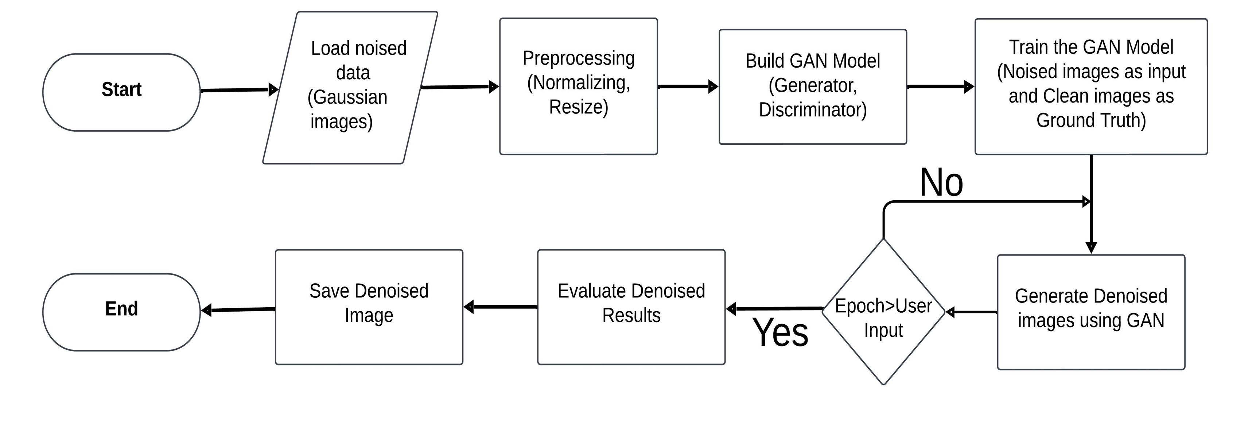
Framework/Methodology

Slide 15
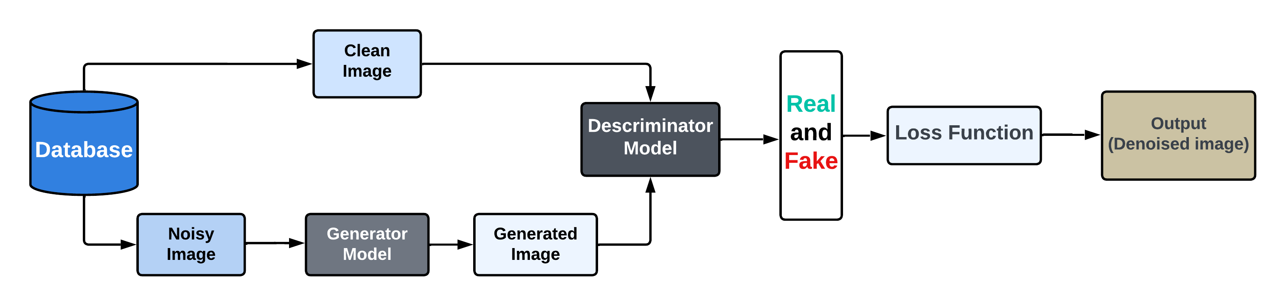
Architecture Diagram

Slide 16
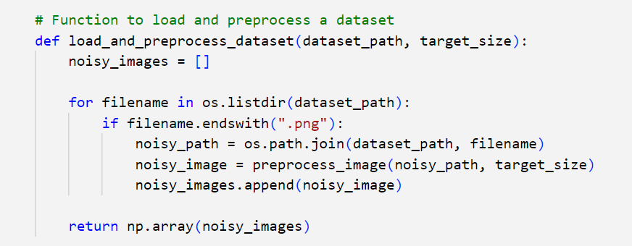
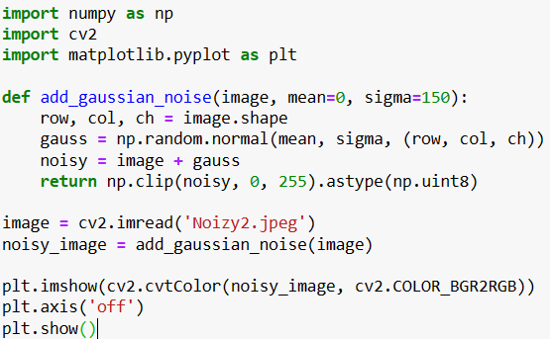
Important code snippets
Preprocessing of Image:
Noise function:

Slide 17
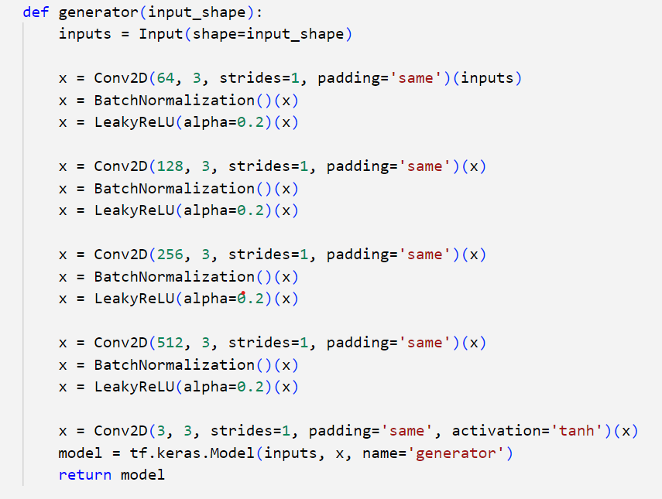
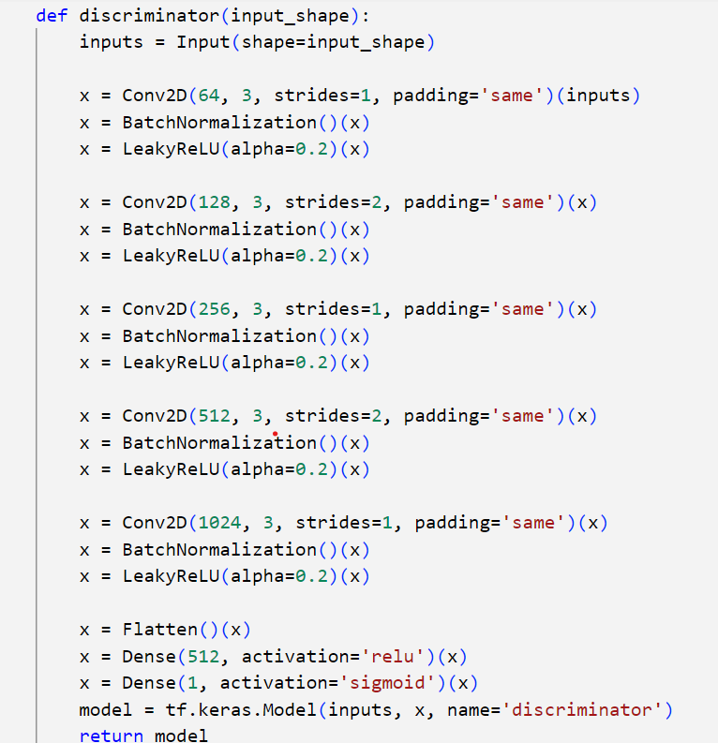
Important code snippets
Generator Code:
Discriminator Code:

Slide 18
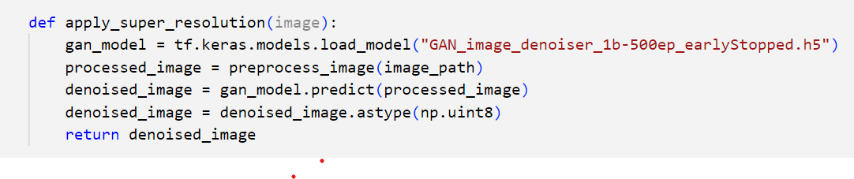
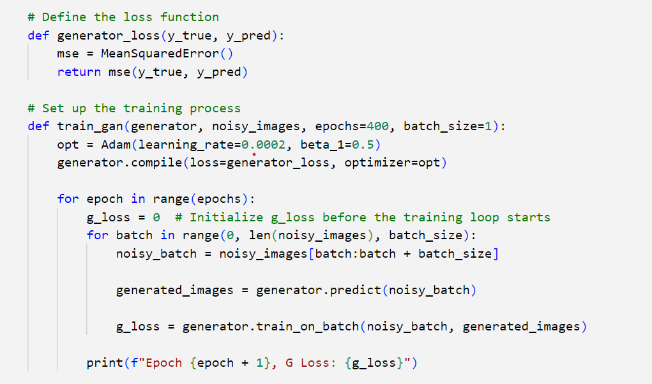
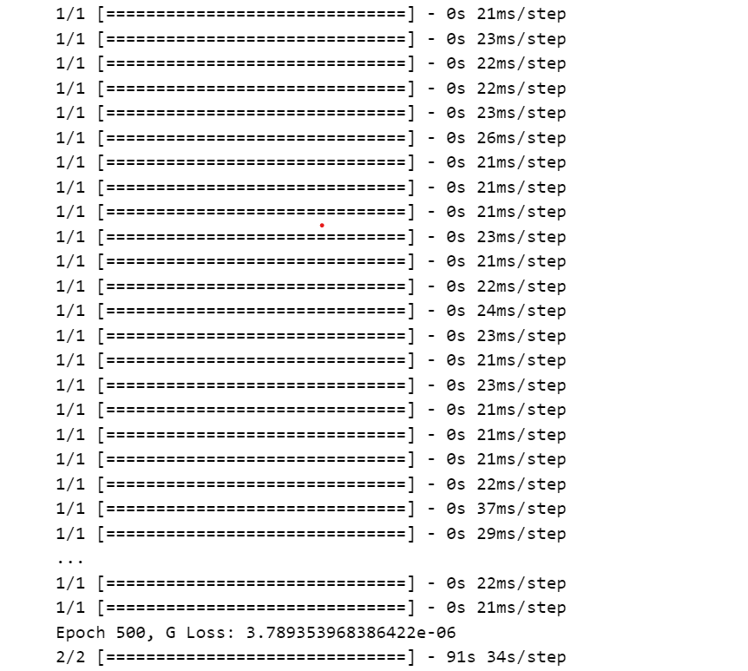
Important code snippets
Implementation model into the GUI:
Training and Loss function:
Training (Epochs):

Slide 19
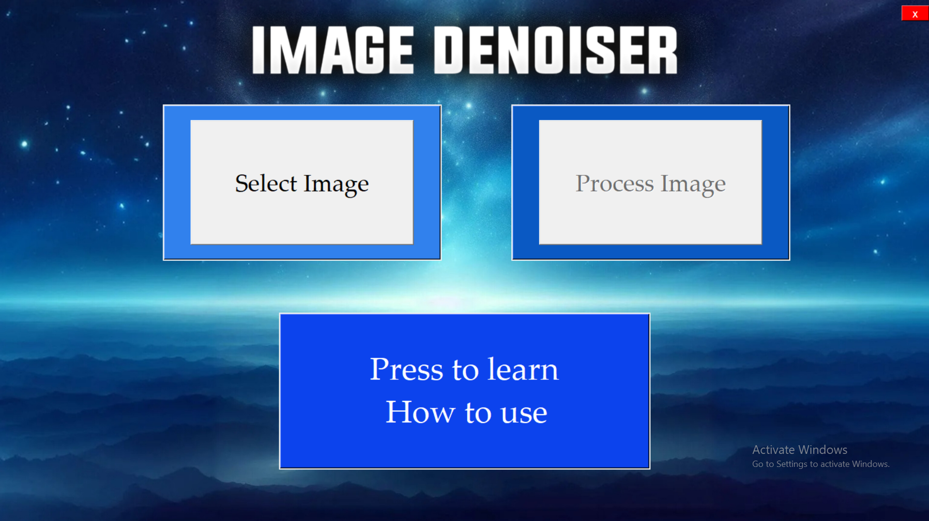
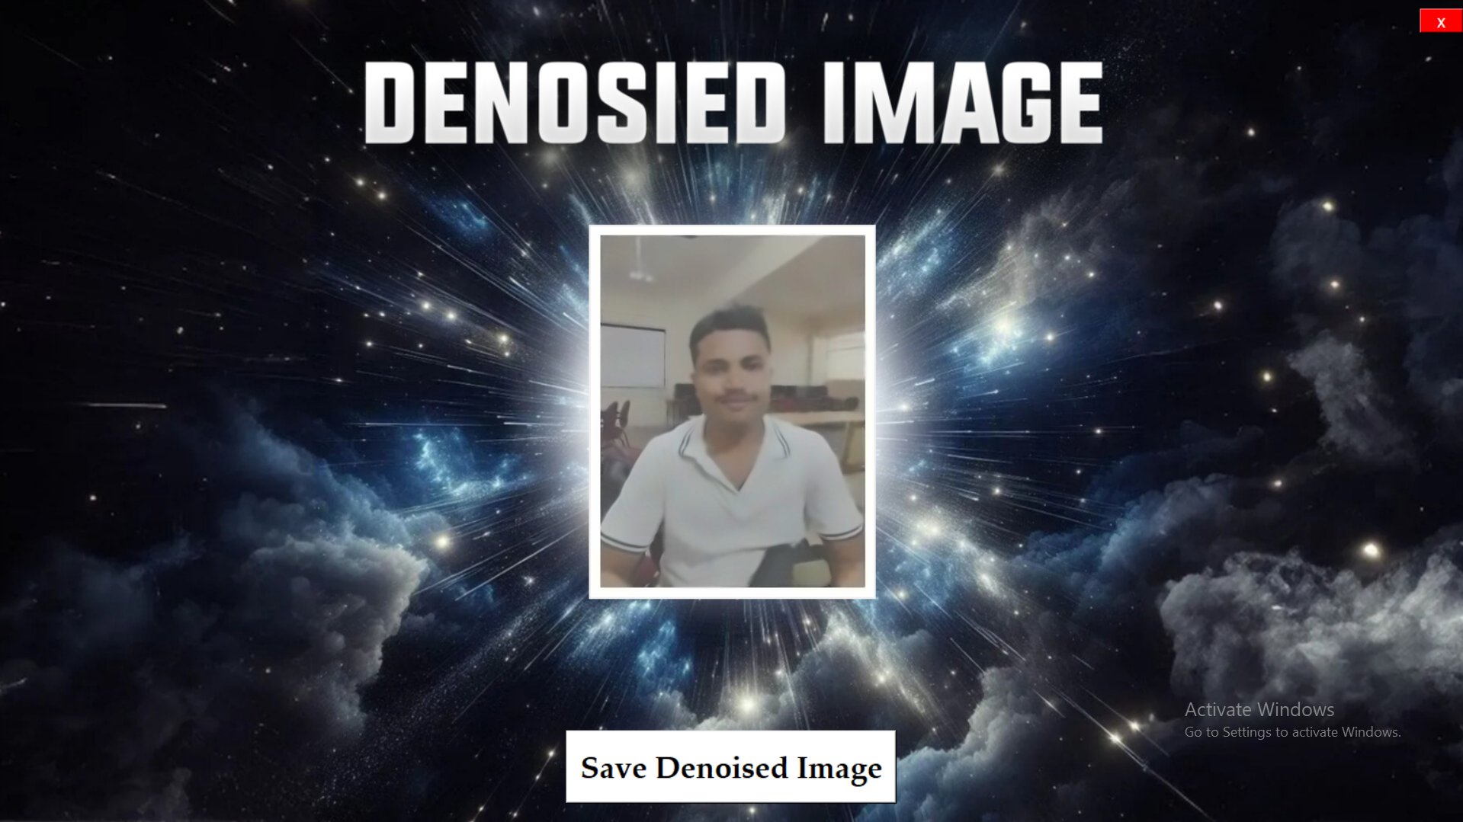
Front-end for our project
GUI Landing page:
GUI Result page:

Slide 20
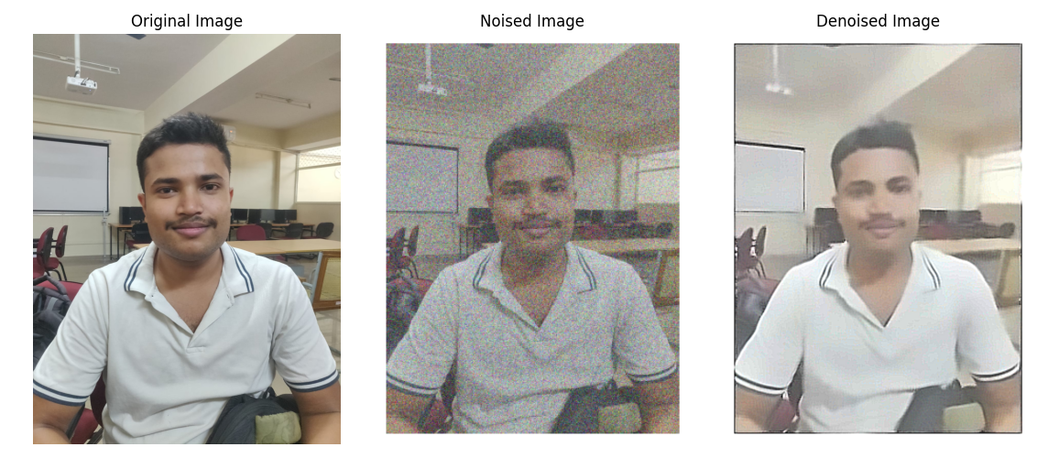
Result and Discussions

Slide 21
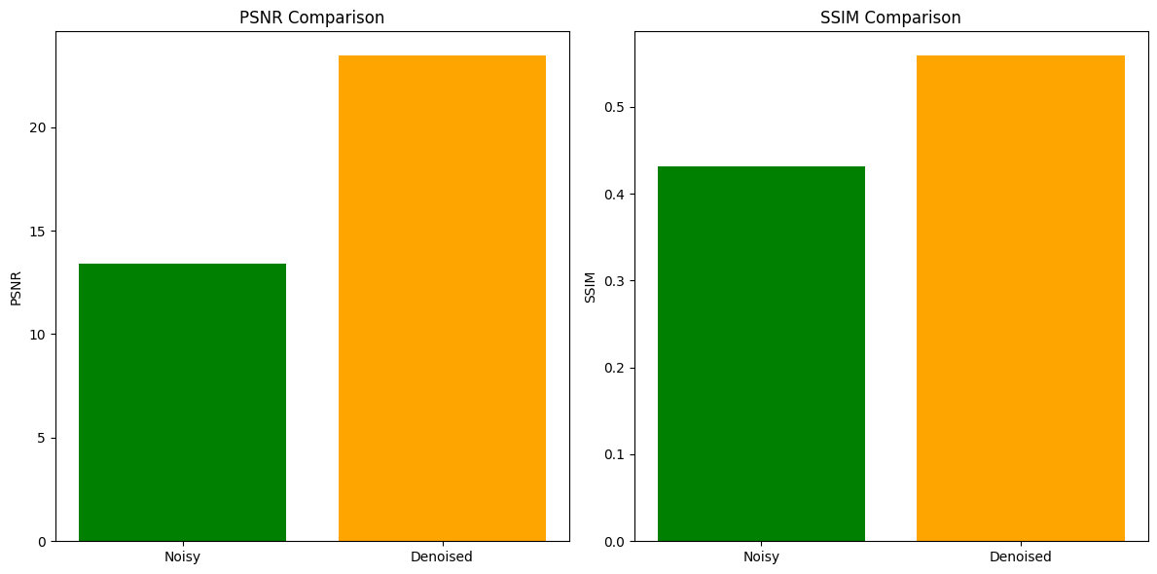
Analysis with Original Image

Slide 22
Future Scope
Research opportunities utilising Generative Adversarial Networks (GANs) to eliminate or reduce Gaussian noise in real-world images are extremely promising.
Improved GAN Architectures: Enhance GAN architectures to better adapt to the complex and dynamic nature of CCTV images. Utilize deep learning techniques to enhance noise reduction capabilities while preserving important details.
Exploration of Advanced Training Techniques: Investigate cutting-edge training methods such as meta-learning and self-supervised learning to enhance the resilience and applicability of noise reduction models in various surveillance scenarios and environmental conditions.
Incorporation of Domain-specific Knowledge: Integrate domain-specific knowledge, such as understanding common noise patterns in security images, to develop more targeted and effective noise reduction algorithms.
Mobile Application: We are planning to develop a user-friendly app to facilitate real-time noise reduction in CCTV images. The app development process will involve prototyping, user interface design, integration with CCTV systems, extensive testing, optimization, and deployment across multiple platforms.

Slide 23
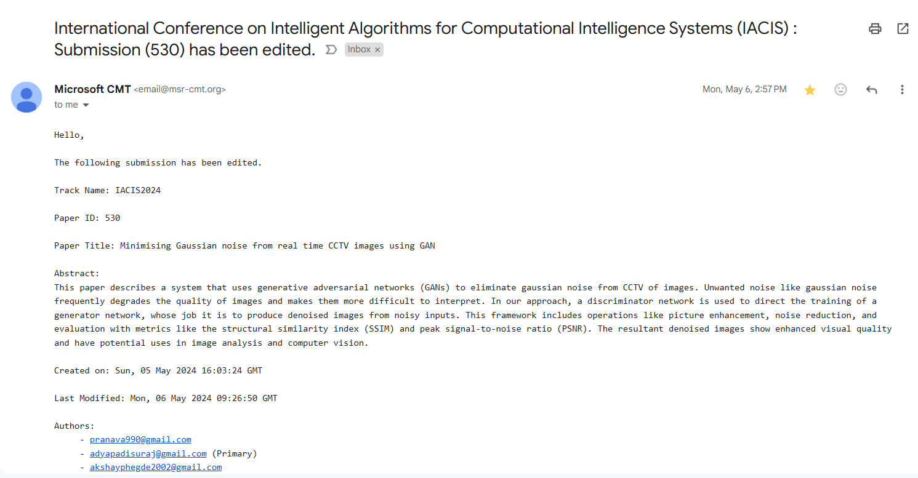
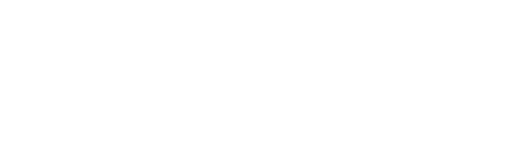
Conference Submission

Slide 24
References
An Unbiased Risk Estimator for Image Denoising in the Presence of Mixed Poisson–Gaussian Noise DOI: 10.1109/TIP.2014.2300821
Gaussian noise estimation with superpixel classification in digital images
10.1109/CISP.2012.6469838
Undecimated wavelet-based Bayesian denoising in mixed Poisson-Gaussian noise with application on medical and biological images
10.1109/IPTA.2014.7001926
Multi-Scale Patch-Based Image Restoration
10.1109/TIP.2015.2499698
EDCNN: A Novel Network for Image Denoising
10.1109/ICIP.2019.8804293
A New Generative Adversarial Network for Texture Preserving Image Denoising
10.1109/IPTA.2018.8608126

Slide 25

Thank you

